Slide 1


Siva Krishna
23-06-2024

Slide 2

Outline
Executive Summary
Introduction
Methodology
Results
Conclusion
Appendix

Slide 3
Executive Summary
Collected data from public SpaceX API and SpaceX wiki page. Extracted Falcon 9 data from the tables and performed actions on it.Explored data using SQL, visualization, folium maps and dashboard. Used one hot encoding on categorical variables to binary. Performed machine learning models on data and visulalized accuracy score for each model.
Used four machine learning models to find the predicted successful landings.Four machine learning models were Logistic Regression, Support Vector Machine, Decision Tree and K NN. All the four models produced the same accuracy rate of 83%

Slide 4
Introduction
SpaceX advertises Falcon 9 rocket launches on its website with a cost of 62 million dollars other providers cost upward of 165 million dollars each, much of the savings is because SpaceX can reuse the first stage. Therefore if we can determine if the first stage will land, we can determine the cost of a launch. This information can be used if an alternate company wants to bid against SpaceX for a rocket launch.
Space Y tasks us to train a machine learning model to predict successful Stage 1 recovery

Slide 5

Section 1

Slide 6
Methodology
Executive Summary
Data collection methodology:
Gathered and merged data from SpaceX API and SpaceX Wiki page
Perform data wrangling
Identifying true landings as successful and false landings as unsuccessful
Perform exploratory data analysis (EDA) using visualization and SQL
Perform interactive visual analytics using Folium and Plotly Dash
Perform predictive analysis using classification models
Used GridSearchCV

Slide 7
Data Collection
Collected data from SpaceX API requests and web scraping data from a table in SpaceX wiki.
You need to present your data collection process use key phrases and flowcharts

Slide 8
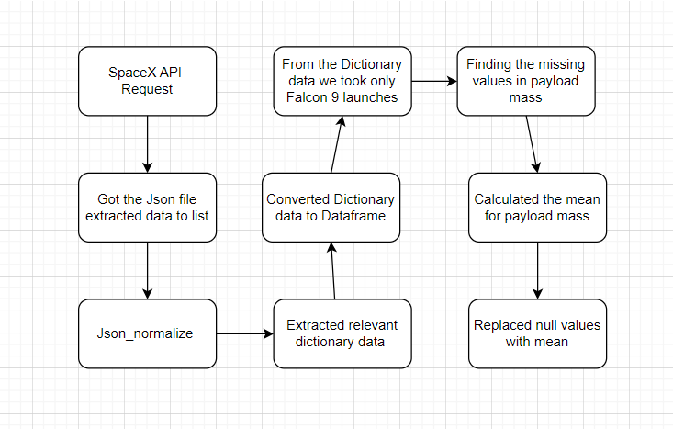
Data Collection – SpaceX API
Data collection with SpaceX REST calls using key phrases and flowcharts
https://github.com/kasula111/Final-Capstone-Data-science-project.git

Slide 9
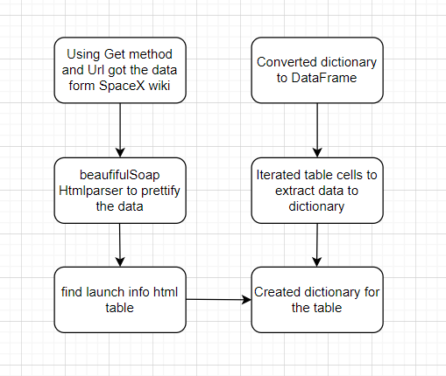
Data Collection - Scraping
Web scraping process using key phrases and flowcharts
GitHub URL https://github.com/kasula111/Final-Capstone-Data-science-project.git

Slide 10
Data Wrangling
Created a training label with landing outcomes where successful = 1 & failure = 0.
Outcome column has two components: ‘Mission Outcome’ ‘Landing Location’
New training label column ‘class’ with a value of 1 if ‘Mission Outcome’ is True and 0 otherwise.
Value Mapping: True ASDS, True RTLS, & True Ocean – set to -> 1
None None, False ASDS, None ASDS, False Ocean, False RTLS – set to -> 0
Add the GitHub URL of your completed data wrangling related notebooks, as an external reference and peer-review purpose

Slide 11
EDA with Data Visualization
EDA performed on Filght number, Payload Mass, Launch Site, Orbit, Class and Year
Plots Used:
Flight Number vs. Payload Mass, Flight Number vs. Launch Site, Payload Mass vs. Launch Site, Orbit vs. Success Rate, Flight Number vs. Orbit, Payload vs Orbit, and Success Yearly Trend.
Add the GitHub URL of your completed EDA with data visualization notebook, as an external reference and peer-review purpose

Slide 12
EDA with SQL
Loaded data set into IBM DB2 Database.
Queried using SQL Python integration.
Queried information about launch site names, mission outcomes, various pay load sizes of customers and booster versions, and landing outcomes.
Add the GitHub URL of your completed EDA with SQL notebook, as an external reference and peer-review purpose

Slide 13
Build an Interactive Map with Folium
Folium maps mark launch sites, successful and unsuccessful landings and key locations of launching
This provides visualize info on launch sites and where they are located.
Also visualizes successful landings relative to location.
Add the GitHub URL of your completed interactive map with Folium map, as an external reference and peer-review purpose

Slide 14
Build a Dashboard with Plotly Dash
Summarize what plots/graphs and interactions you have added to a dashboard
Explain why you added those plots and interactions
Add the GitHub URL of your completed Plotly Dash lab, as an external reference and peer-review purpose

Slide 15
Predictive Analysis (Classification)
Summarize how you built, evaluated, improved, and found the best performing classification model
You need present your model development process using key phrases and flowchart
Add the GitHub URL of your completed predictive analysis lab, as an external reference and peer-review purpose

Slide 16
Results
Exploratory data analysis results
Interactive analytics demo in screenshots
Predictive analysis results

Slide 17

Section 2

Slide 18
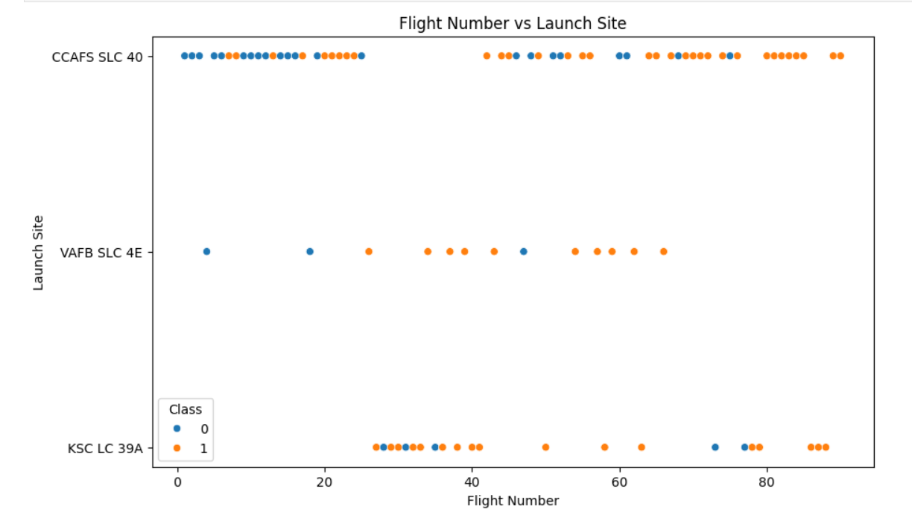
Flight Number vs. Launch Site
Scatter plot of Flight Number vs. Launch Site
Graph suggests an increase in success rate over time
CCAFS appears to be the main launch site as it has the most volume
GitHub URL https://github.com/kasula111/Final-Capstone-Data-science-project.git

Slide 19
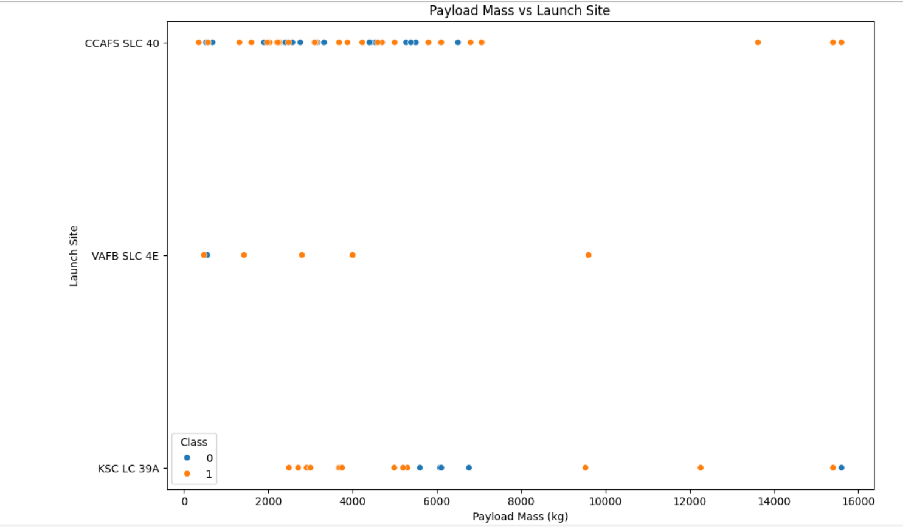
Payload vs. Launch Site
Scatter plot of Payload vs. Launch Site
Payload mass appears to fall mostly between 0-6000 kg.
Different launch sites also seem to use different payload mass
GitHub URL https://github.com/kasula111/Final-Capstone-Data-science-project.git

Slide 20
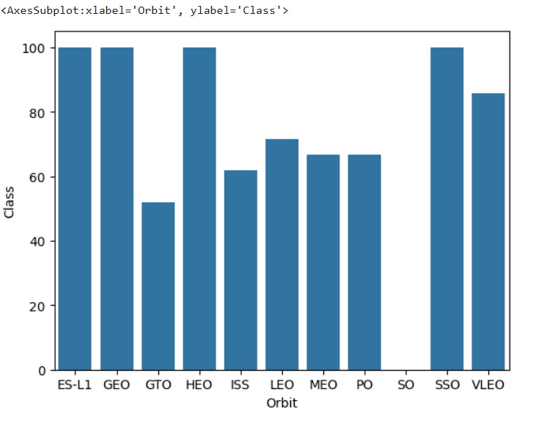
Success Rate vs. Orbit Type
Bar chart for the success rate of each orbit type
Success Rate Scale with 0 as 0%, 0.6 as 60%, 1 as 100%
ES-L1 (1), GEO (1), HEO (1) have 100% success rate SSO (5) has 100% success rate
VLEO (14) has decent success rate and attempts
SO (1) has 0% success rate
GTO (27) has the around 50% success rate but largest sample
GitHub URL https://github.com/kasula111/Final-Capstone-Data-science-project.git

Slide 21
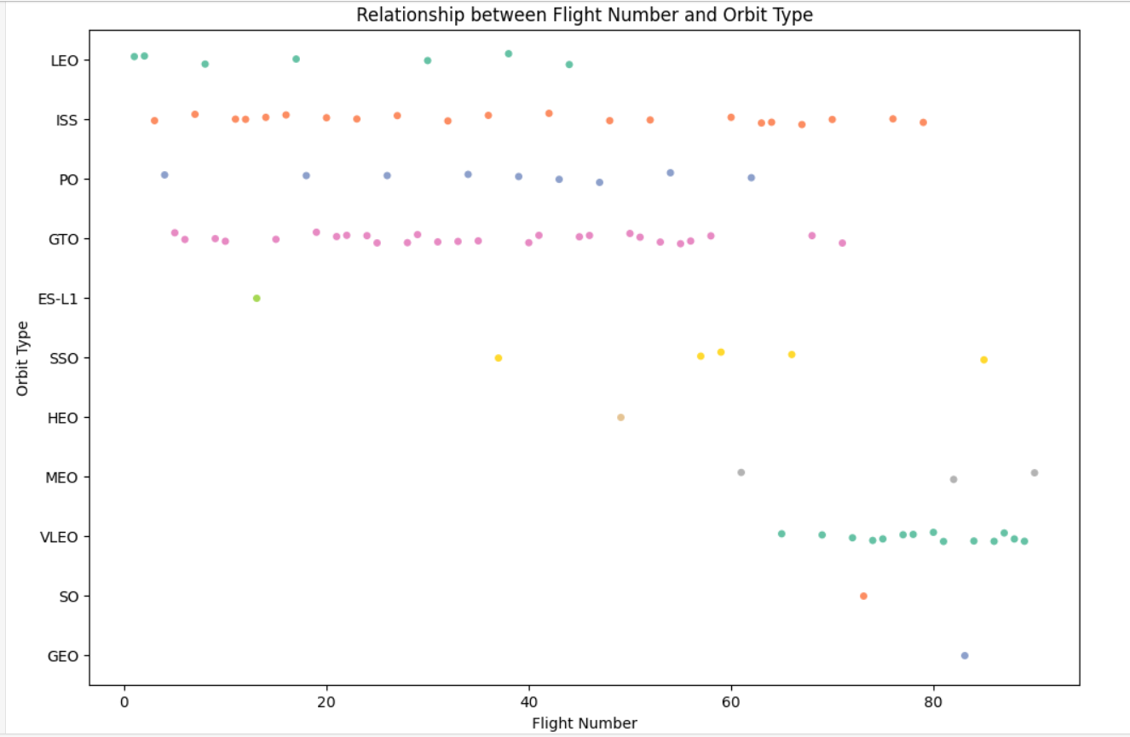
Flight Number vs. Orbit Type
Scatter point of Flight number vs. Orbit type
Launch Orbit preferences changed over Flight Number.
Launch Outcome seems to correlate with this preference.
SpaceX started with LEO orbits which saw moderate success LEO and returned to VLEO in recent launches
SpaceX appears to perform better in lower orbits or Sun-synchronous orbits

Slide 22
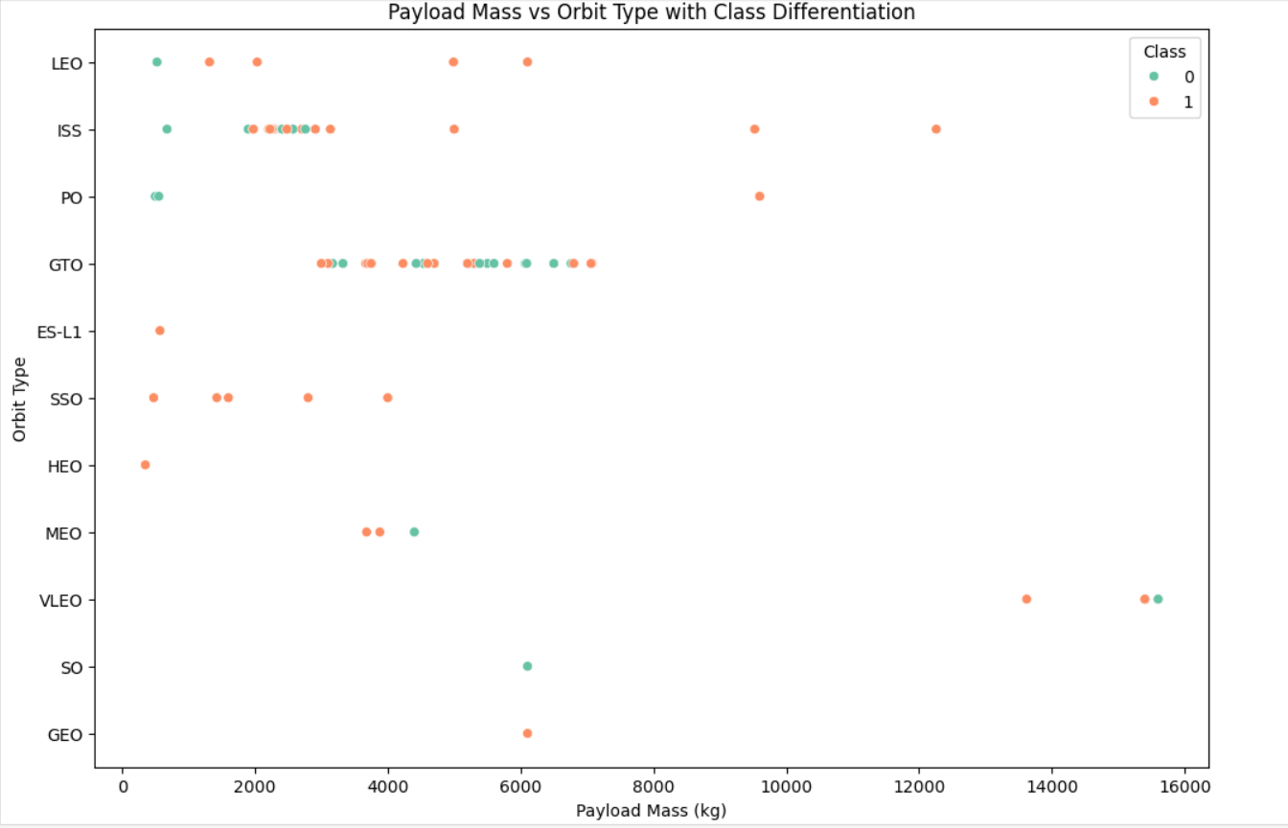
Payload vs. Orbit Type
Scatter plot point of payload vs. orbit type
The most successful orbit LEO only has payload mass values in the higher end of the range

Slide 23
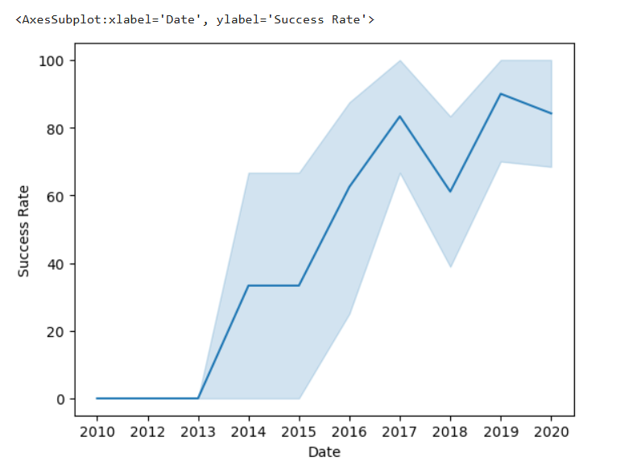
Launch Success Yearly Trend
Line chart of yearly average success rate
Success generally increases over time since 2013 with a slight dip in 2018
Success in recent years at around 80%ions

Slide 24
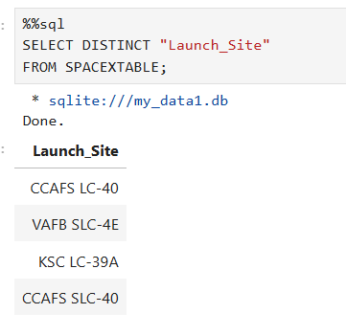
All Launch Site Names
Find the names of the unique launch sites
CCAFS LC-40, CCAFS SLC-40 are belongs to same launch site
So there are 3 unique launch sites.

Slide 25
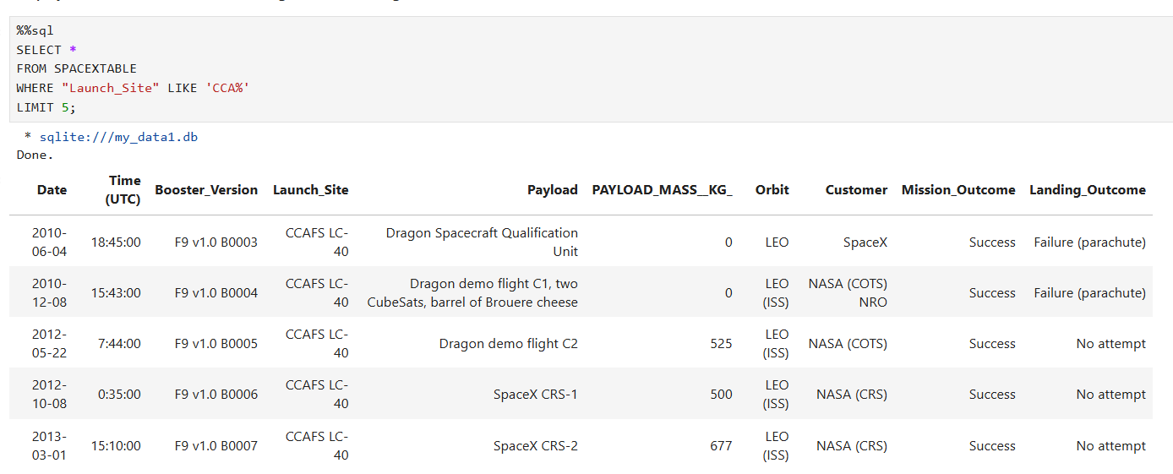
Launch Site Names Begin with 'CCA'
Find 5 records where launch sites begin with `CCA`

Slide 26
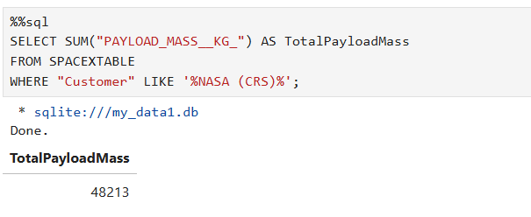
Total Payload Mass
Calculate the total payload carried by boosters from NASA

Slide 27
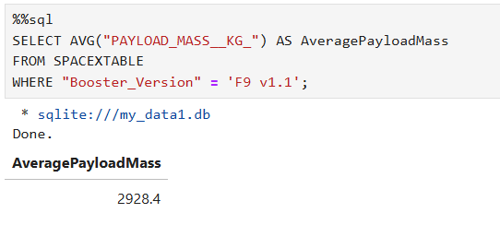
Average Payload Mass by F9 v1.1
Calculate the average payload mass carried by booster version F9 v1.1

Slide 28
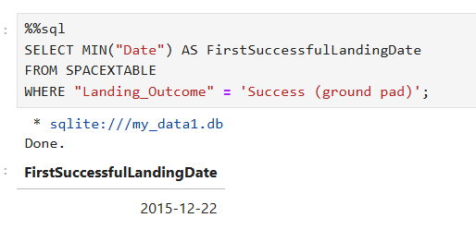
First Successful Ground Landing Date
Find the dates of the first successful landing outcome on ground pad

Slide 29
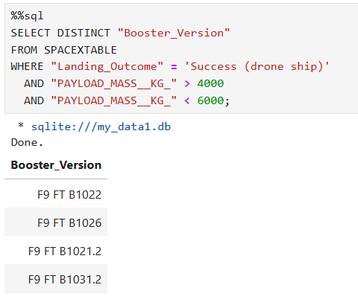
Successful Drone Ship Landing with Payload between 4000 and 6000
List the names of boosters which have successfully landed on drone ship and had payload mass greater than 4000 but less than 6000

Slide 30
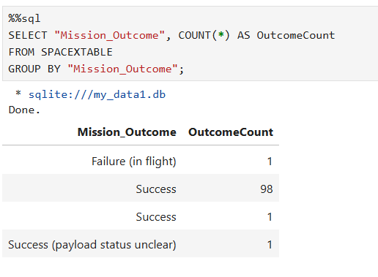
Total Number of Successful and Failure Mission Outcomes
Calculate the total number of successful and failure mission outcomes

Slide 31
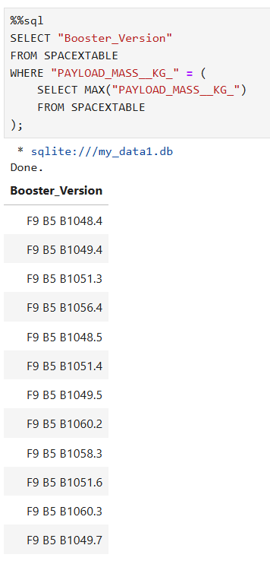
Boosters Carried Maximum Payload
List the names of the booster which have carried the maximum payload mass

Slide 32
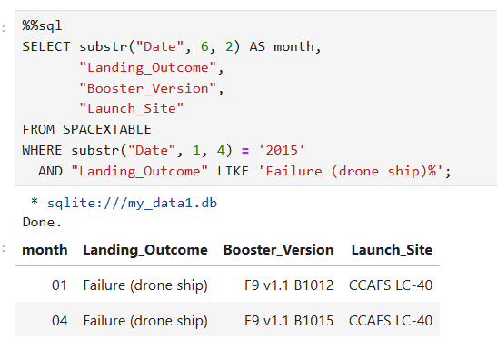
2015 Launch Records
List the failed landing_outcomes in drone ship, their booster versions, and launch site names for in year 2015

Slide 33
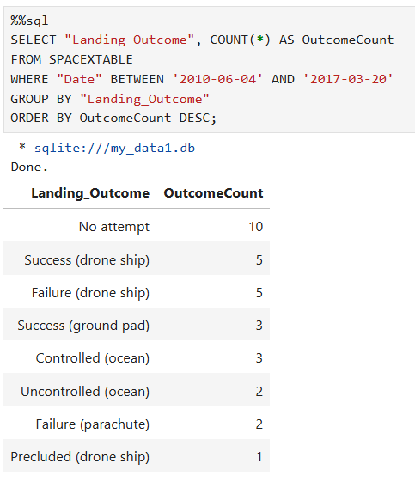
Rank Landing Outcomes Between 2010-06-04 and 2017-03-20
Rank the count of landing outcomes (such as Failure (drone ship) or Success (ground pad)) between the date 2010-06-04 and 2017-03-20, in descending order
GitHub URL https://github.com/kasula111/Final-Capstone-Data-science-project.git

Slide 34

Section 3

Slide 35
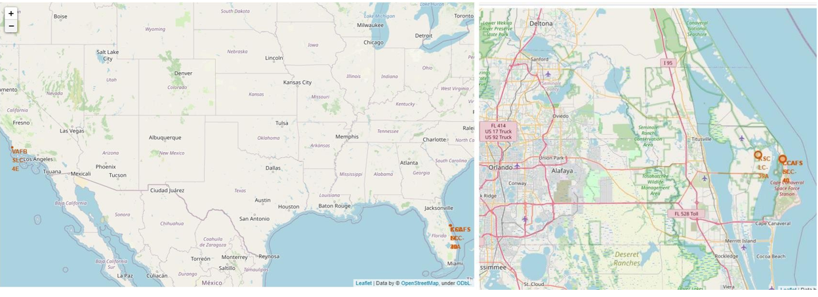
<Folium Map Screenshot 1>
Replace <Folium map screenshot 1> title with an appropriate title
Explore the generated folium map and make a proper screenshot to include all launch sites’ location markers on a global map
Explain the important elements and findings on the screenshot

Slide 36
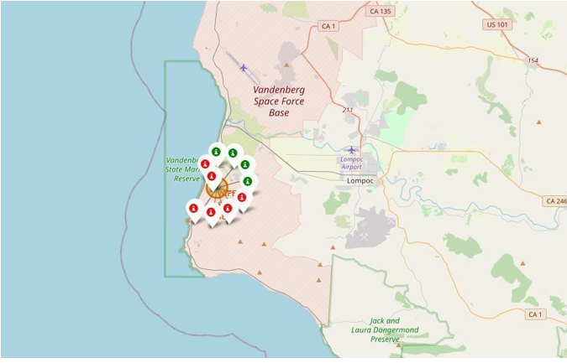
<Folium Map Screenshot 2>
Replace <Folium map screenshot 2> title with an appropriate title
Explore the folium map and make a proper screenshot to show the color-labeled launch outcomes on the map
Explain the important elements and findings on the screenshot

Slide 37
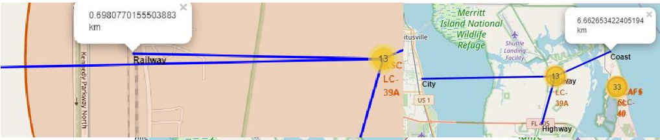
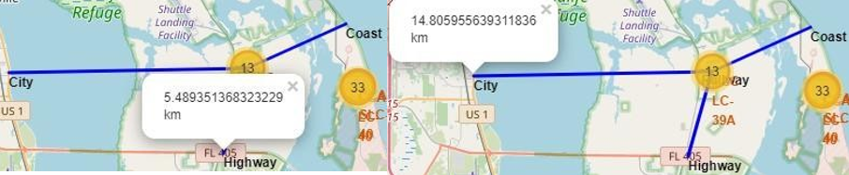
<Folium Map Screenshot 3>
Replace <Folium map screenshot 3> title with an appropriate title
Explore the generated folium map and show the screenshot of a selected launch site to its proximities such as railway, highway, coastline, with distance calculated and displayed
Explain the important elements and findings on the screenshot

Slide 38

Section 4

Slide 39
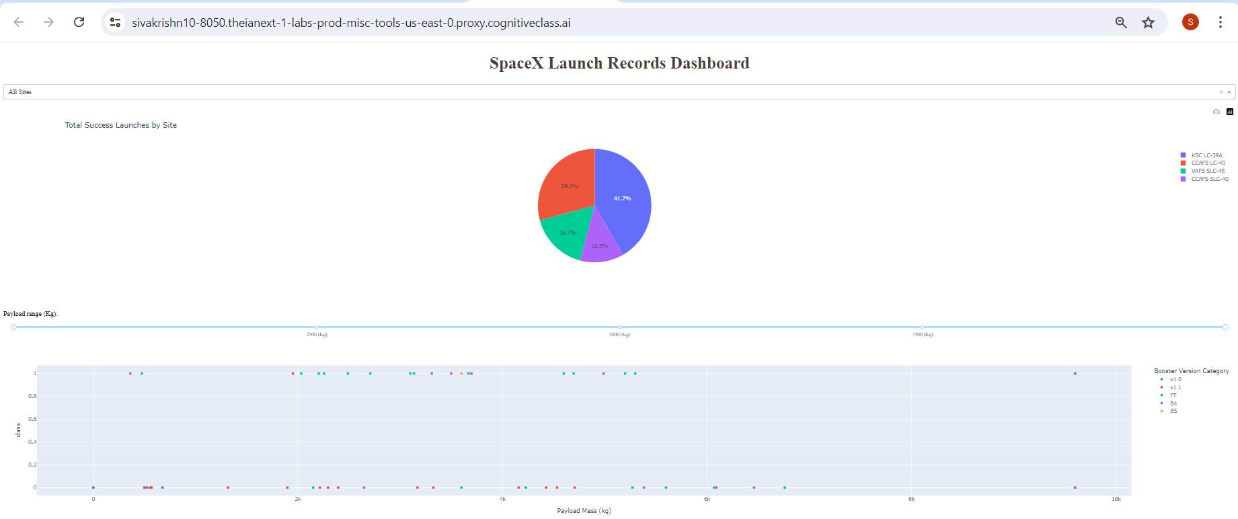
<Dashboard Launch Success rate>
Replace <Dashboard screenshot 1> title with an appropriate title
Show the screenshot of launch success count for all sites, in a piechart
Explain the important elements and findings on the screenshot

Slide 40
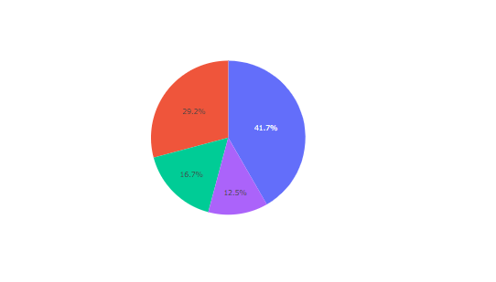

<Dashboard pie chart for the launch site with highest launch success ratio >
Replace <Dashboard screenshot 2> title with an appropriate title
Show the screenshot of the piechart for the launch site with highest launch success ratio
Explain the important elements and findings on the screenshot

Slide 41
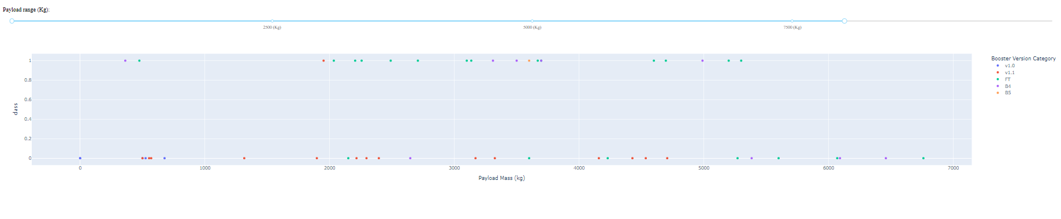
<Dashboard Payload Vs Launch Outcome>
Replace <Dashboard screenshot 3> title with an appropriate title
Show screenshots of Payload vs. Launch Outcome scatter plot for all sites, with different payload selected in the range slider
Explain the important elements and findings on the screenshot, such as which payload range or booster version have the largest success rate, etc.

Slide 42

Section 5

Slide 43
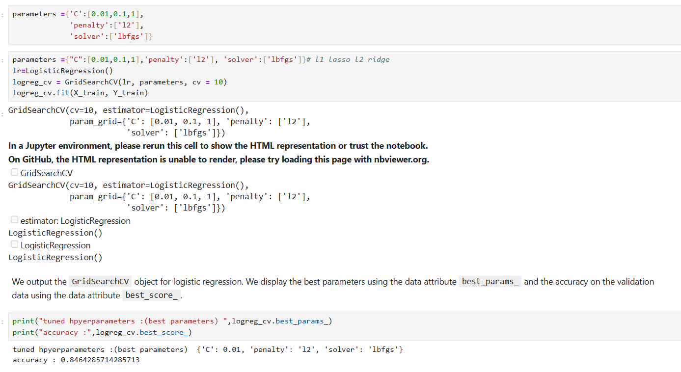
Classification Accuracy
Visualize the built model accuracy for all built classification models, in a bar chart
Find which model has the highest classification accuracy

Slide 44
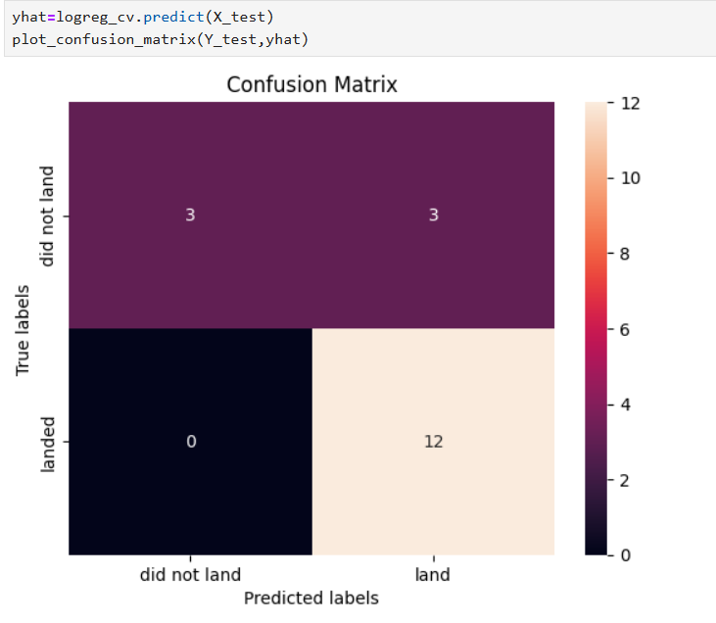
Confusion Matrix
Confusion matrix of the best performing model with an explanation.
Since all models performed the same for the test set, the confusion matrix is the same across all models. The models predicted 12 successful landings when the true label was successful landing.
The models predicted 3 unsuccessful landings when the true label was unsuccessful landing.
The models predicted 3 successful landings when the true label was unsuccessful landings (false positives). Our models over predict successful landings.

Slide 45
Conclusions
Task is to develop a machine learning model for Space Y who wants to bid against SpaceX
The goal of model is to predict when Stage 1 will successfully land to save ~$100 million USD
Used data from a public SpaceX API and web scraping SpaceX Wiki page
Created data labels and stored data into a DB2 SQL database
Created a dashboard for visualization
We created a machine learning model with an accuracy of 83%
Allon Mask of SpaceY can use this model to predict with relatively high accuracy whether a launch will have a successful Stage 1 landing before launch to determine whether the launch should be made or not
If possible more data should be collected to better determine the best machine learning model and improve accuracy.

Slide 46
Appendix
Git Hub repository link:
https://github.com/kasula111/Final-Capstone-Data-science-project.git

Slide 47


